Slide 1
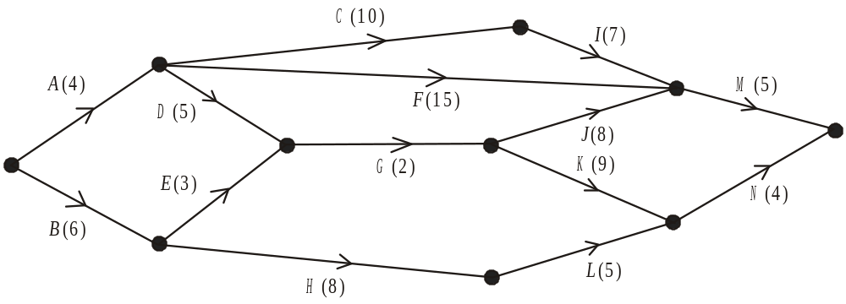
Critical Path Analysis
In Critical Path Analysis, the minimum time needed to complete a connected sequence of tasks is found. Tasks which have flexibility in when they can take place are identified and a schedule to complete the tasks in the minimum time is devised.
Eg The network in the figure below shows the activities involved in a process.
The activities are represented by the arcs.
The number in brackets on each arc gives the time, in days, taken to complete the activity.
Eg G cannot start until D and E have been completed

Slide 2
Representing connected tasks as a network
A precedence table is used to show which activities must take place before another activity can start
Activity | Must be preceded by
A
B
C
D
E
F
G
H
I
J
K
L
M
N
_
Eg The network in the figure below shows the activities involved in a process.
The activities are represented by the arcs.
The number in brackets on each arc gives the time, in days, taken to complete the activity.
_
A
A
B
A
D,E
B
C
G
G
H
In order to establish the minimum time needed to complete the entire project, precedence of activities must be considered.
F,I,J
K,L

Slide 3


Dummies
A dummy activity is sometimes needed to correctly represent precedents
Activity | Must be preceded by
A | –
B | –
C | A, B
D | A, B
E | A
E
A
D
B
C
Dummy 1:
Dummies are represented with a dashed line
C and D can only happen once A & B have been completed, whereas E only needs A to have happened
Dummy 2:
C and D must be represented uniquely as events – you will see why later

Slide 4
WB9. The precedence table for activities involved in producing a computer game is shown below.
An activity on arc network is to be drawn to model this production process.
(a) Explain why it is necessary to use at least two dummies when drawing the activity network.
(b) Draw the activity network using exactly two dummies.
Activity | Must be preceded by
A | –
B | –
C | B
D | A, C
E | A
F | E
G | E
H | G
I | D, F
J | G, I
K | G, I
L | H, K
Activity
Dummy activity
E
G
H
A
K
L
F
B
C
D
I
J

Slide 5
Critical Path Analysis
To establish the optimum schedule, we use algorithms to find:
The earliest time each activity can start - early event times
The latest time each activity can start without delaying the project - late event times
Which activities must be done at specific times – critical activities
How much flexibility the other, non-critical activities have - float
Once this is done, we can create a diagram a bit like a box plot to show all the information clearly – a cascade or Gantt chart
We can then create another diagram to show how the activities could be allocated to workers in order to minimise the labour (and therefore costs) of the process/project – a schedule

Slide 6
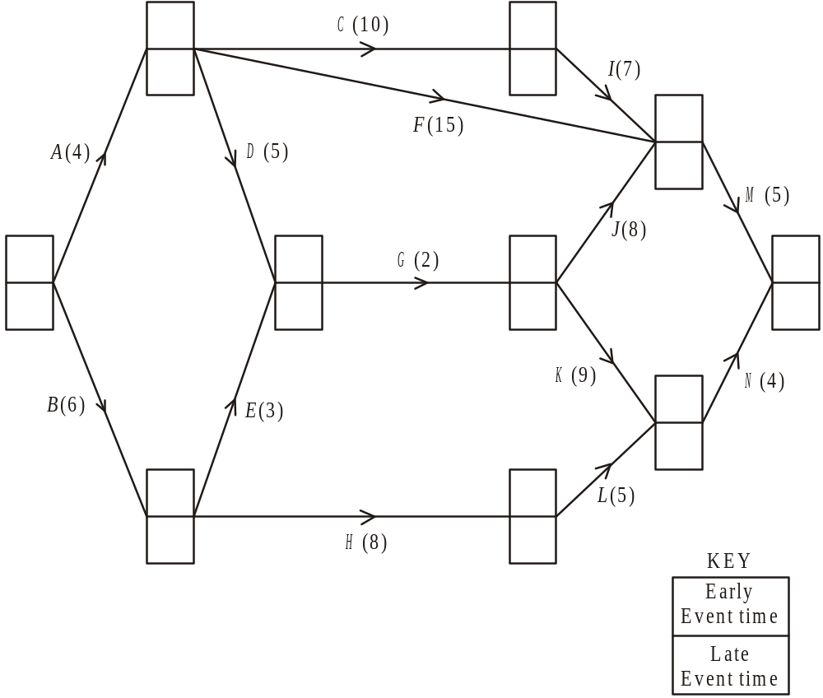
Early event times are the earliest time an activity can commence
Early event time is the largest total into a node, working forwards
Key
4+10=14
Early event time
Late event time
4
14
14+7=21
4+15=19
21
0+4=4
21+5=26
4+5=9
11+8=19
0
9
11
26
9+2=11
11+9=20
0+6=6
6+3=9
20
20+4=24
6
6+8=14
14
WB10
14+5=19

Slide 7
Late event times are the latest time an activity can commence
Late event time is the smallest total into a node, working backwards
Key
14-10=4
Early event time
Late event time
4
14
21-7=14
4
14
21-15=6
21
4-4=0
21
26-5=21
11-5=6
21-8=13
0
9
11
26
0
11
13-2=11
13
26
22-9=13
8-6=2
11-3=8
20
26-4=22
22
6
17-8=9
14
8
17
22-5=17

Slide 8
If an activity must take place at a specific time it is called critical
An activity (arc) is critical if early event time = late event time at both ends of the arc, and the difference between these numbers equals the length of the arc
Critical activities:
4
14
4
14
A
C
I
M
21
Critical path ACIM
21
Not critical
0
9
11
26
0
11
13
26
20
22
6
14
Key
17
Early event time
Late event time
8
A chain of critical activities forms a critical path

Slide 9










If activities are not critical, they have some flexibility in when they can happen
This is measured by the Float F_{x} = late finish time - length of activity - early start time
Floats:
4
14
4
14
21
21
0
9
11
26
0
11
13
26
20
22
6
14
Key
8
17
Early event time
Late event time
Note: as A, C, I and M critical, their float must be zero

Slide 10
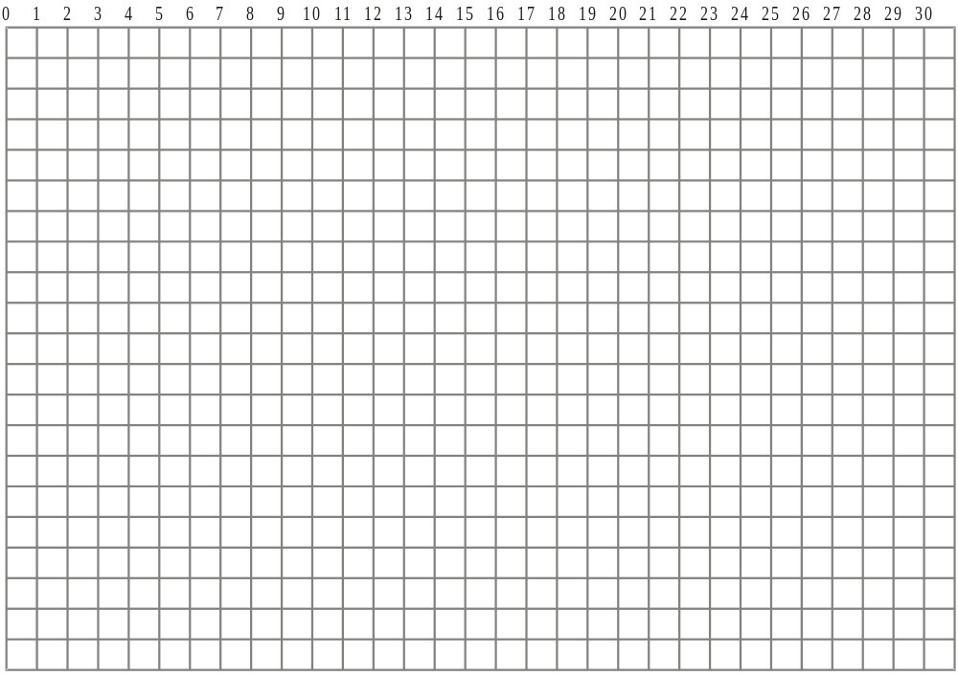










c) On the grid below, draw a cascade (Gantt) chart for the process.
A
C
I
M
B
D
E
F
G
H
J
K
L
Early & late finish times
N
Draw each critical path on its own line
4
14
4
14
21
Draw each non-critical activity on its own line
21
0
9
11
26
0
11
13
26
For non-critical activities, draw a box from the early start till the late finish time, then shade off the float to show the flexibility
20
22
6
14
8
17

Slide 11
Interpreting a cascade (Gantt) chart
C is critical so must be done on day 6
A
C
I
M
B
B
I is critical so must be done on day 19
D
D does not need to be done on day 6
B must still be done on day 6
D
E
F must still be done on day 19
E
F
F does not need to be done on day 6
F
G
G
J must still be done on day 19
H
H
J
J
K
K
Likewise K and L
L
L
N
N
The minimum number of workers needed on any day can be identified by drawing a vertical line and seeing how many tasks it must pass through
Eg on day 6
you need 2 workers (for tasks C and B)
Eg on day 19
you need 5 workers (tasks I, F, J, K and L)
The minimum number of workers needed to complete the project on time is equal to the maximum number of workers needed on any day
5 workers needed (Eg day 19)

Slide 12
e) Schedule the activities, using the number of workers you found in part (d), so that the process is completed in the shortest time.
Worker 1
A
C
I
M
Worker 2
B
D
G
J
N
Worker 3
E
H
L
Worker 4
F
Worker 5
K
A
C
I
M
B
B
D
D
E
E
F
F
G
G
H
H
J
J
Gantt chart:
K
K
L
5 workers needed
L
N
N

